Slide 1
Preventing homelessness: Some observations
Guy Johnson,
Professor of Urban Housing and Homelessness
Director, Unison Housing Research Lab
Homelessness Australia, August 23, 2023

Slide 2
(USA)
(Denmark)
Kuhn, R. and D. Culhane (1998). 'Applying cluster analysis to test a typology of homelessness by pattern of shelter utilization: Results from the analysis of administrative data', American Journal of Community Psychology.
Benjaminsen, L. and S. Andrade (2015). 'Testing a typology of Homelessness across welfare regimes: Shelter Use in Denmark and the US', Housing Studies. 6(30): 858-876.

Slide 3
PROPOSITION
Homelessness in countries with extensive welfare systems is more likely to be concentrated amongst individuals with complex support needs, such as mental illness or substance abuse, whereas homelessness in countries with less extensive welfare systems is more likely to result from poverty and housing affordability problems.

Slide 4
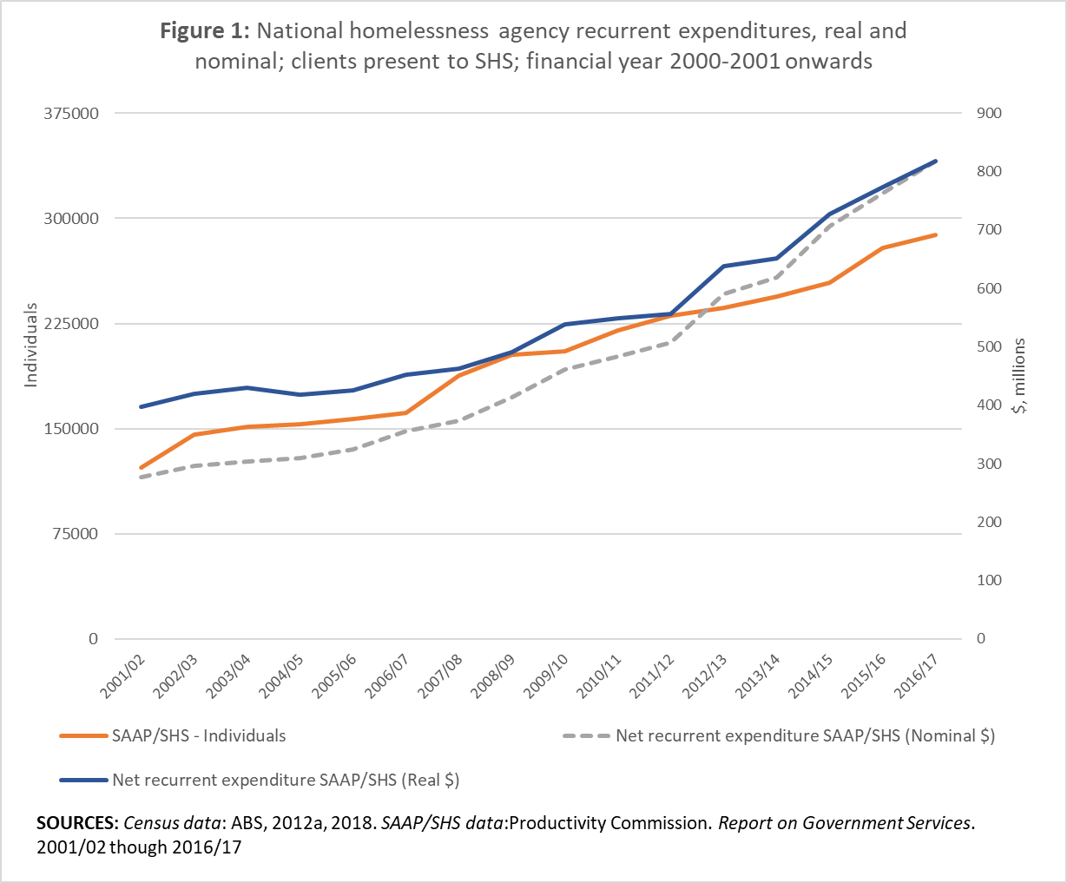

Slide 5
(Significant) Effects of individual characteristics
No Effect
Long term health condition
Risk factors^
ATSI
Ever in State care
Ever slept rough
Recent job loss
Recent violence
Alcohol consumption
Drug use
Preventative Factors^^
Year 12 or post school qual
Time employed (%) past
Ever diagnosed bipolar / schizophrenia
Resident children
Social Support
Community Housing
Preventative Factors^^
Year 12 or post school qual
Time employed (%) past
Ever diagnosed bipolar / schizophrenia
Resident children
Social Support
Community Housing
PUBLIC HOUSING
^ INCREASE probability of entering homelessness
^ DECREASE probability of entering homelessness
SOURCE: Johnson, G., Scutella, R., Tseng, Y., & Wood, G. (2018). How do housing and labour markets affect individual homelessness? Housing Studies, 34(7), 1089-1116.

Slide 6
Select references
Benjaminsen, L., & Andrade, S. (2015). Testing a typology of Homelessness across welfare regimes: Shelter Use in Denmark and the US. Housing Studies, 6(30), 858-876.
Cobb-Clark, D., Herault, N., Scutella, R., & Tseng, Y. (2016). A Journey Home: What drives how long people are homeless? Journal of Urban Economics, 91, 57-72.
Johnson, G., Scutella, R., Tseng, Y., & Wood, G. (2018). How do housing and labour markets affect individual homelessness? Housing Studies, 34(7), 1089-1116.
Kithulgoda, C., Vaithianathan, R., & Culhane, D. (2022). Predictive Risk Modelling to Identify Homeless Clients at Risk of Prioritizing Services using Routinely Collected Data. Journal of Technology in Human Services, 40(2), 134-156.
Kuehnle, D., Johnson, G., & Tseng, Y. (2023). Making it home? Evidence on the long-run impact of an intensive support program for the chronically homeless on housing, employment and health. Journal of Urban Economics, 133.
Kuhn, R., & Culhane, D. (1998). Applying cluster analysis to test a typology of homelessness by pattern of shelter utilization: Results from the analysis of administrative data. American Journal of Community Psychology, 26(2), 207-232.
Moschion, J., & Johnson, G. (2019). Homelessness and Incarceration: A Reciprocal Relationship? Journal of Quantitative Criminology, 35(4), 855-887.
O'Flaherty, B., Scutella, R., & Tseng, Y. (2017). Using private information to predict homelessness entries: Evidence and prospects. Housing Policy Debate.
Scutella, R., & Johnson, G. (2018). Psychological distress and homeless duration. Housing Studies, 33(3), 433-454.
Scutella, R., Johnson, G., Mocschion, J., Tseng, Y., & Wooden, M. (2013). Understanding lifetime homeless duration: investigating wave 1 findings from the Journeys Home project. Australian Journal of Social Issues, 48(1), 83-110.
Scutella, R., Wood, G., & Johnson, G. (2021). Sitting in the waiting room: do people experiencing homelessness underutilize health services? Housing and Society, 48(3).

