Slide 1
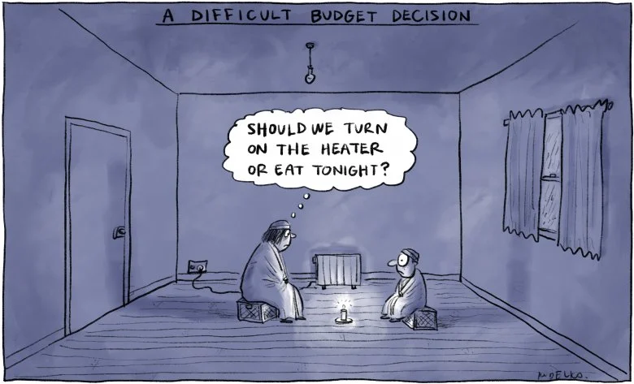
The context
Income drivers of homelessness
IMAGE
Jacqueline Phillips
Deputy CEO/ Director of Policy (job-share)
23 August 2023
(@jonkudelka and The Saturday Paper)

Slide 2
Current income support payment rates for people who are unemployed
2023 Federal Budget changes and new rates of payment
$40 per fortnight increase to JobSeeker and related payments (plus 2.2% indexation)
From $693.10 per fortnight ($49.50 per day) to $749.20 per fortnight ($56 per day)
Partnered rate (no dependents) $631.20 per fortnight ($45 per day) to increase to $685.20 per fortnight ($49 per day)
Additional increase for JobSeekers from age 55 years, unemployed >9 months to $802.50 per fortnight
Youth Allowance increase
From $562.80 per fortnight ($40 per day) to $616 per fortnight ($44 per day)
15% increase to Rent Assistance payments
Single parents with children aged 8 to 14 years old eligible for Parenting Payment
From $693.10 per fortnight ($49.50 per day) to $922.10 per fortnight ($66 per day)
Notes:
As well as increases to base payments, the Government should index all income support payments twice a year to wages and prices, as the gap between payment types continue to widen. For example, Youth Allowance indexed once per year to CPI grows more slowly than JobSeeker, which is indexed twice per year in line with CPI, and has not maintained pace with pensions, which is indexed to a different price inflation measure (the PBLCI), as well as wages.
A Disability and Illness Supplement would recognise the additional costs faced by people with disability and illness while they receive JobSeeker and related payments. At the same time, there are too many people with disability receiving JobSeeker payments who should more appropriately receive the Disability Support Pension. • A Single Parent Supplement of at least $200 per week should be introduced to recognise the additional costs for single parent households. That payment should replace Family Tax Benefit Part B.
Income support payments could also be simplified by rolling universal payments, such as the Energy Supplement, into base rates. There are many other barriers for people accessing the payments they need that should be removed or reduced, including: • Permanently removing the Liquid Assets Waiting Period and One Week Waiting Period • reducing the Newly Arrived Residents Waiting Period to a maximum of six months (as it was when introduced) • increasing permanent staff numbers at Centrelink, including social workers • ensuring people seeking asylum and temporary migrants have access to crisis support and financial assistance when needed.

Slide 3
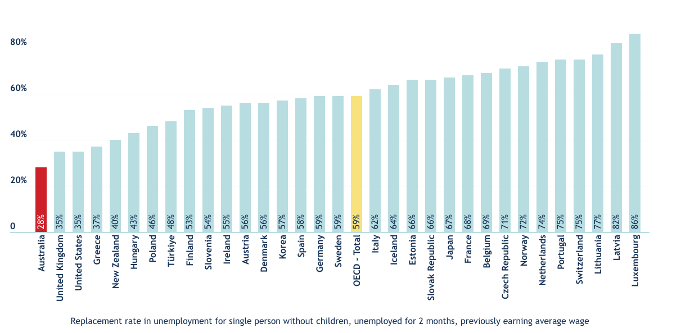
In global context: the lowest benefit replacement rate in the OECD (prior to 2023 budget)
SOURCE: OECD tax-benefit data portal. Note: housing assistance included.
Notes:
Australia had the lowest benefit replacement rate in the OECD, with a single person who had previously worked at the average wage receiving just 28 per cent of their previous disposable income, including assistance with housing costs, compared to an OECD average of 59 per cent. This calculation is based on people paying 20 per cent of the average wage for their rent, which in the case of Australia would be around $360 per week. On this measure, Australia drops to having the lowest level in the OECD, primarily because assistance with housing costs is more generous in the United Kingdom and New Zealand.

Slide 4
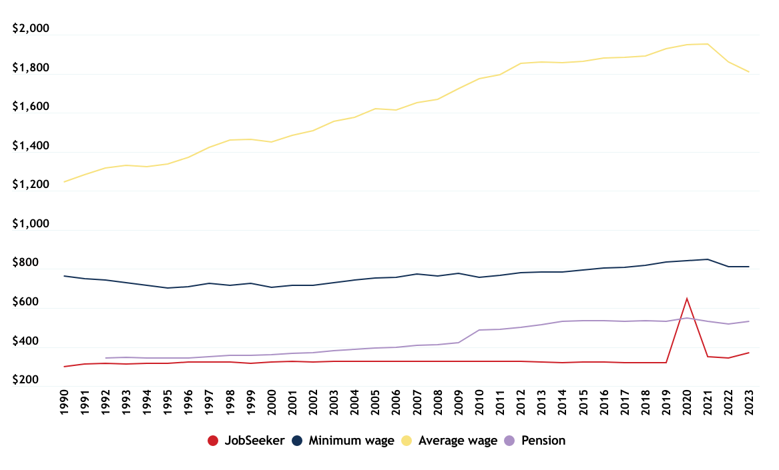
JobSeeker comparison with wages and pensions ($2023)
SOURCE: ACOSS calculations
Notes:
The 2023-24 Budget’s increase to JobSeeker, while a start, does not provide enough of an increase to bring JobSeeker to Pension rates, and still leaves it much lower than minimum or average wage.
Income support rates should be based on need, and protect people from homelessness, hunger, poverty and social isolation.
Rates should be equitable, based on actual costs of living, rather than the type of payment a person receives.
Current inequities are particularly stark between people with disability with similar needs receiving the higher Disability Support Pension and people with disability or chronic illness receiving JobSeeker.
They can also be seen in the relative rates of payments for singles and couples.

Slide 5
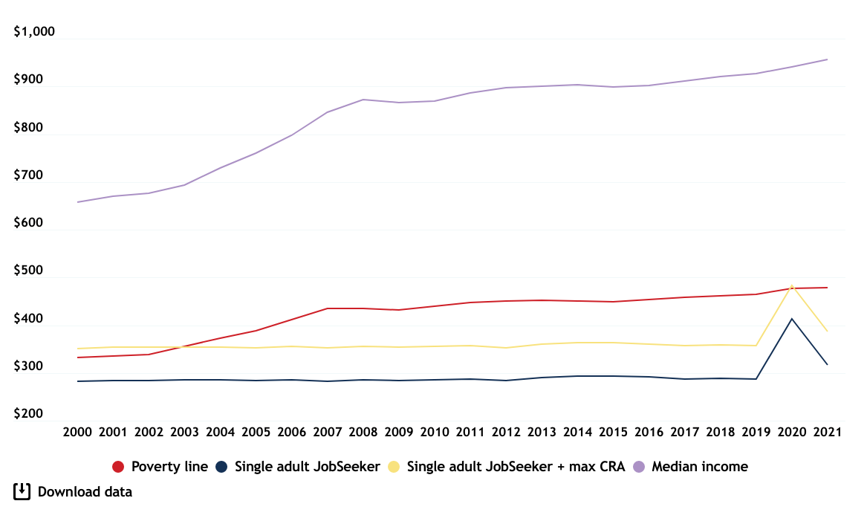
JobSeeker comparison with poverty line, 2000 - 2021($2021)
SOURCE: ACOSS calculations
Notes:
The 2023-24 Budget’s increase to JobSeeker, while a start, does not provide enough of an increase to bring JobSeeker to Pension rates, and still leaves it much lower than minimum or average wage.

Slide 6
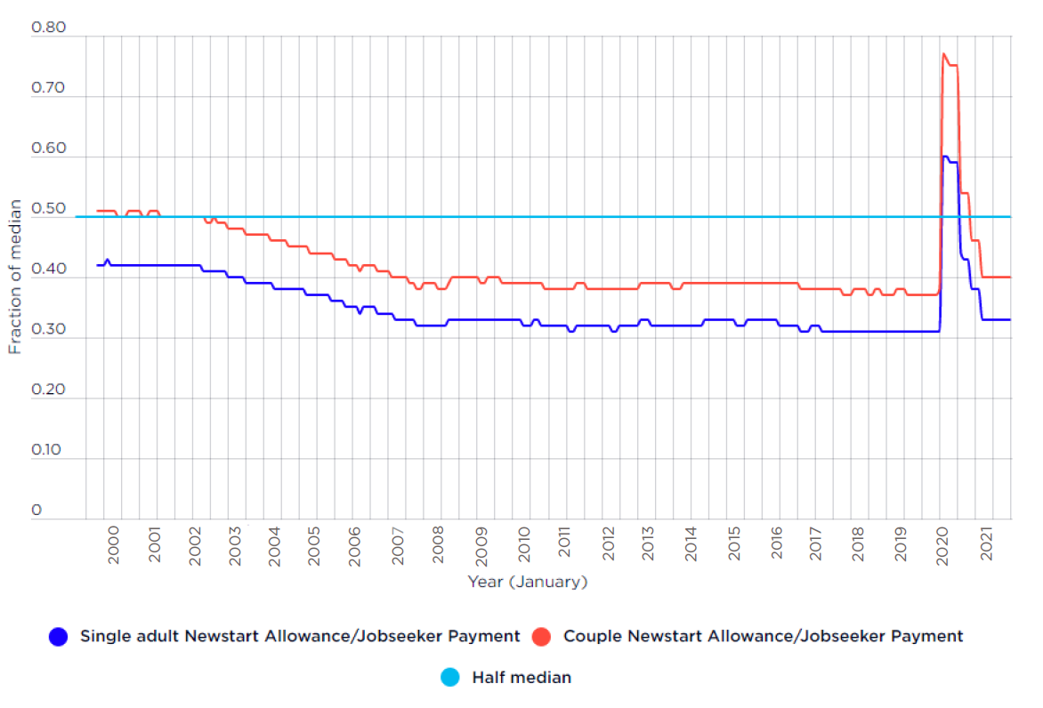
JobSeeker as % of poverty line, 2000 - 2021
SOURCE: ACOSS calculations
Notes:
The 2023-24 Budget’s increase to JobSeeker, while a start, does not provide enough of an increase to bring JobSeeker to Pension rates, and still leaves it much lower than minimum or average wage.

Slide 7
ACOSS social security policy proposals
Lift Jobseeker and Youth Allowance payments to parity to pensions (currently a $XX a week increase) and index to both wage and price movements.
Benchmark Rent Assistance to actual rents paid, and index to rent price movements.
Undertake a broader review of Rent Assistance policy settings, including eligibility and targeting.
Introduce a Disability and Single Parent supplement which recognises the additional costs of disability and raising children alone.
Legislate for a permanent, independent, transparent Economic Inclusion Advisory Committee to advise Government on social security policy settings, including adequacy.
Notes:
As well as increases to base payments, the Government should index all income support payments twice a year to wages and prices, as the gap between payment types continue to widen. For example, Youth Allowance indexed once per year to CPI grows more slowly than JobSeeker, which is indexed twice per year in line with CPI, and has not maintained pace with pensions, which is indexed to a different price inflation measure (the PBLCI), as well as wages.
A Disability and Illness Supplement would recognise the additional costs faced by people with disability and illness while they receive JobSeeker and related payments. At the same time, there are too many people with disability receiving JobSeeker payments who should more appropriately receive the Disability Support Pension. • A Single Parent Supplement of at least $200 per week should be introduced to recognise the additional costs for single parent households. That payment should replace Family Tax Benefit Part B.
Income support payments could also be simplified by rolling universal payments, such as the Energy Supplement, into base rates. There are many other barriers for people accessing the payments they need that should be removed or reduced, including: • Permanently removing the Liquid Assets Waiting Period and One Week Waiting Period • reducing the Newly Arrived Residents Waiting Period to a maximum of six months (as it was when introduced) • increasing permanent staff numbers at Centrelink, including social workers • ensuring people seeking asylum and temporary migrants have access to crisis support and financial assistance when needed.

Slide 8
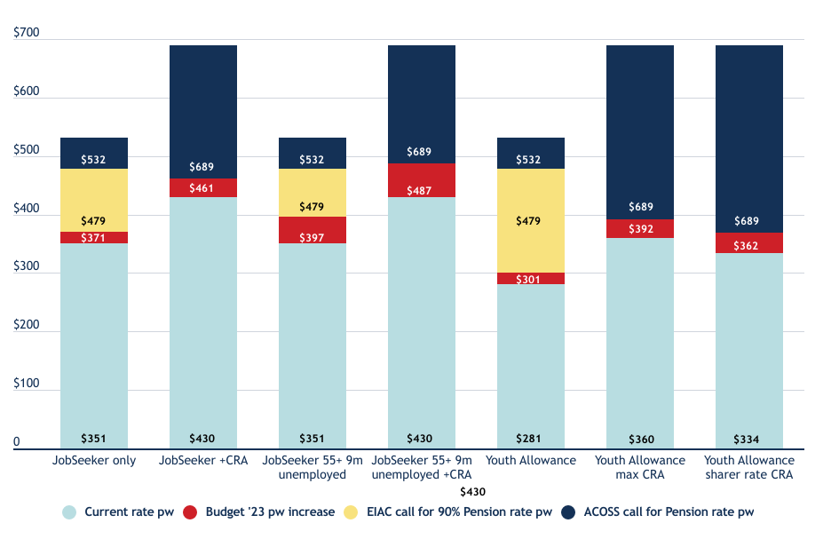
Modelling an increase to JobSeeker and Youth Allowance
SOURCE: ACOSS calculations

Slide 9
Budget standards
 | Single person, FT​ | Single-earner couple​ | Single-earner couple,​ 1 child | Single-earner couple,​ 2 children | Dual-earner couple | Dual-earner couple, 1 child​ | Dual-earner couple, 2 children
Food​ | $87 | $175 | $214 | $271 | $175 | $214 | $271
Personal Care​ | $20 | $38 | $38 | $35 | $39 | $39 | $53
Clothing & Footwear​ | $14 | $20 | $31 | $41 | $27 | $37 | $47
Recreation​ | $39 | $51 | $83 | $101 | $51 | $83 | $101
Household goods & Services​ | $110 | $127 | $153 | $161 | $134 | $155 | $163
Health​ | $12 | $23 | $35 | $47 | $23 | $35 | $47
Transport​ | $118 | $197 | $230 | $231 | $197 | $230 | $231
Education​ | 0​ | 0​ | $24 | $55 | 0​ | $69 | $145
Total (excl housing &​ discretionary) | $400 | $632 | $808 | $942 | $646 | $862 | $1,058
Housing​ | $452 | $489 | $489 | $489 | $489 | $525 | $525
Discretionary​ | $94 | $105 | $99 | $95 | $89 | $118 | $112
Total (excl housing &​ discretionary) | $946 | $1,225 | $1,395 | $1,526 | $1,223 | $1,504 | $1,695
NOTE: Housing costs based on 40th percentile Sydney rents. Weekly $ figures have been adjusted to allow for 6% inflation since June quarter 2022
SOURCE: Bedford, Megan; Bradbury, Bruce and Naidoo, Yuvisthi (2023), Budget Standards for Low-Paid Families. Report prepared for the Fair Work Commission, Melbourne, Australia.

Slide 10
Thank you

Slide 11
Heading

Slide 12
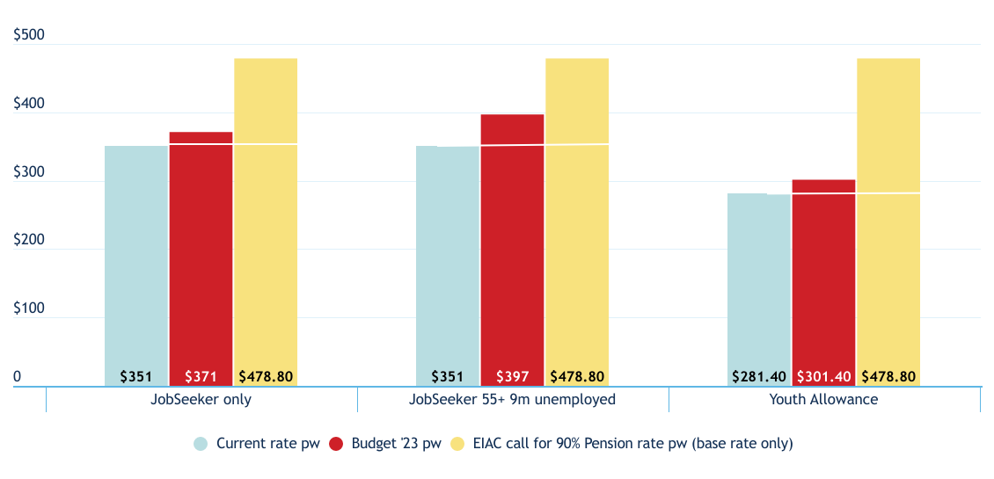
Modelling an increase to JobSeeker and Youth Allowance
SOURCE: ACOSS calculations

Slide 13
Heading

